Slide 2

Objectives
Objective
Understand data fragmentation & replication models

Slide 3
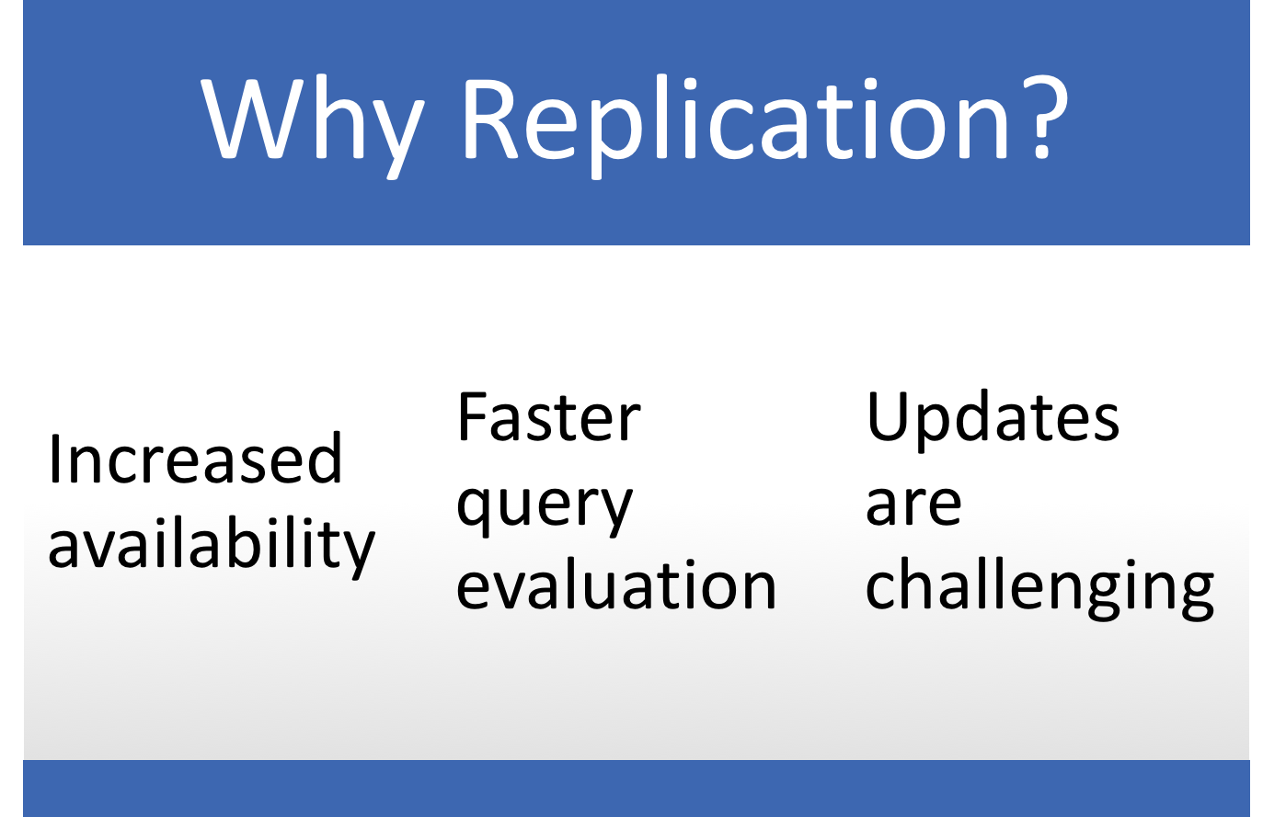

Slide 4
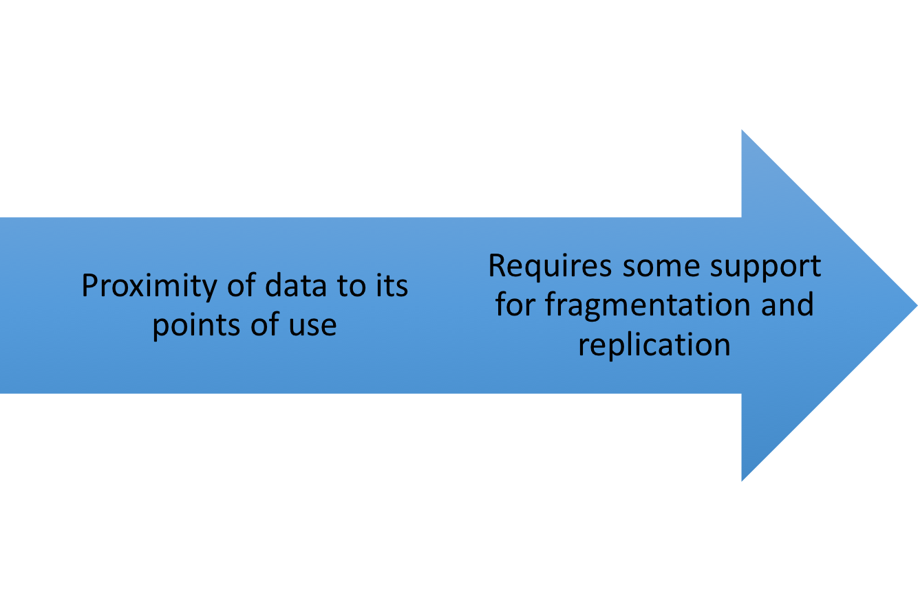
Potentially Improved Performance

Slide 5
Fragmentation Allocation
Problem Statement
  F = {F₁, F₂, …, F_{n}} fragments
  S ={S₁, S₂, …, S_{m}} network sites
  Q = {q₁, q₂,…, q_{q}} applications
Find the "optimal" distribution of F to S.
Optimality
  Minimal cost
  Performance
Response time and/or throughput
  Constraints
Notes:
Optimality
Minimal cost
Communication + storage + processing (read & update)
Cost in terms of time (usually)
Performance
Response time and/or throughput
Constraints
Per site constraints (storage & processing)

Slide 6
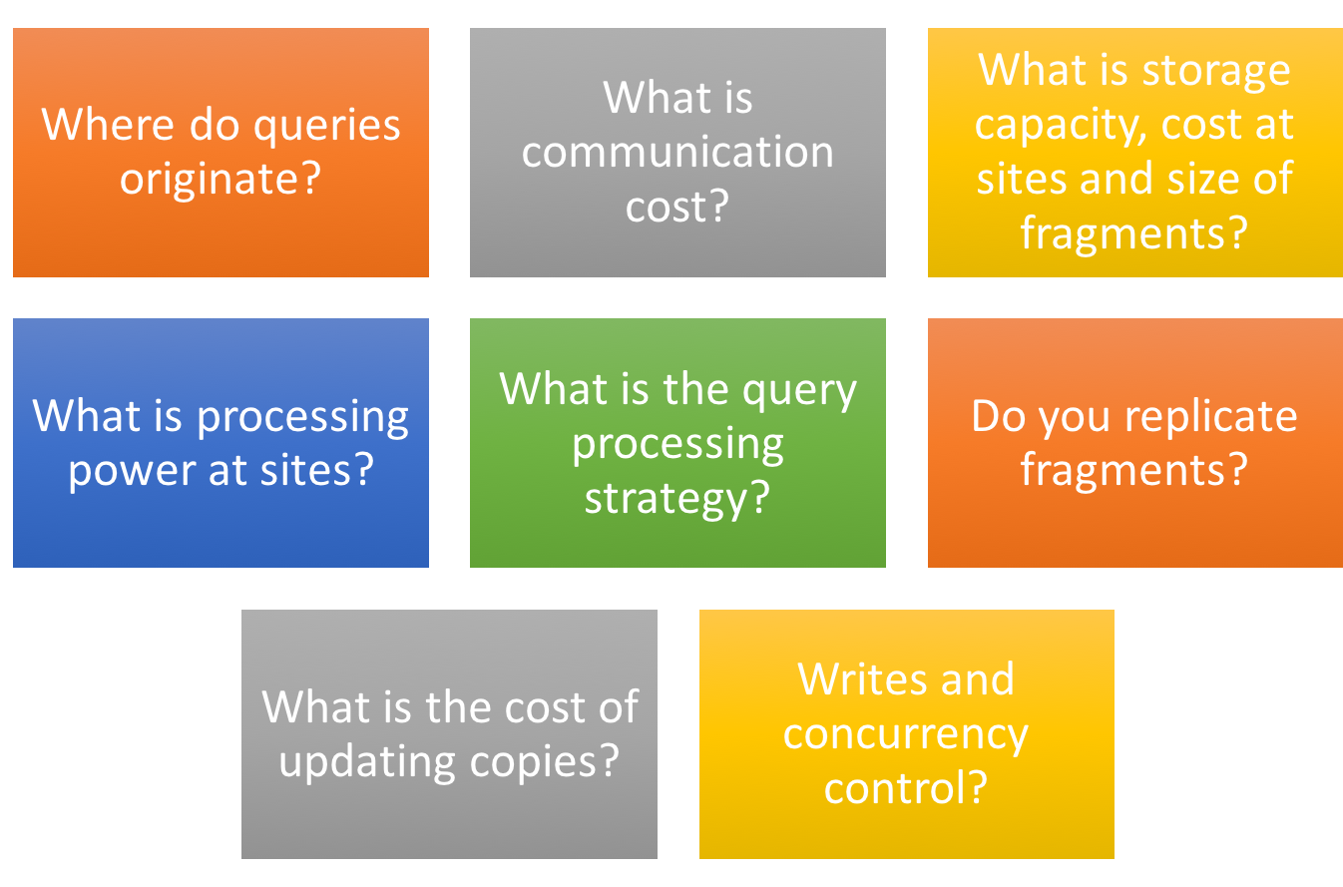
Fragmentation Issues

Slide 7
Optimization Problems
What is best placement of fragments and/or best number of copies to:
  minimize query response time?
  maximize throughput?
  minimize “some cost”?
Subject to constraints:
  What is the available storage?
  What is the available bandwidth, power, etc.
  How can it be kept to 90% of response time below X?

